Slide 1

Cobra Roadshow
October 2022

Slide 2






Zurich | UK Retail
Our Ambition: Be the chosen insurer partner for regional brokers and their customers; through delivery of targeted broker propositions and market leading sales excellence, under pinned by a winning culture and a supportive trading framework
Regional Engagement
Service Proposition
Winning Culture
Data Enrichment
Our regionals underwriters will contact you within 24 hours on all new business quotes when using Broker@
We have multiple contact channels across regions and our SME centres with service levels we are proud of.
Dedicated contacts across our Broker Relationship Management and Telephone Account Management teams
We are structured to drive growth across regional brokers.
Expert Deal management team to support consolidation opportunities
Dedicated New Business Teams per region
5* E-Trade platform
Ongoing focus on regional distribution footprint
Expansion into East Anglia region and looking a new ways of working.
Local UW empowerment ensuring you are speaking to the decision makers
Support for your local communities
Using high quality data to understand how we service your customers
Driving service improvements using key metrics and data insights
Technical ability improvement across both SME and MM

Slide 3




Zurich | Cobra Network, Growing together
Strategically aligned relationship with a strong focus to deliver growth
A dedicated sales contact for every member to increase trading
Access to Young Broker Network, supporting development of emerging professionals within your brokerage
Monthly business development webinars
Enhanced Remuneration
Hunger and Desire to Trade

Slide 4

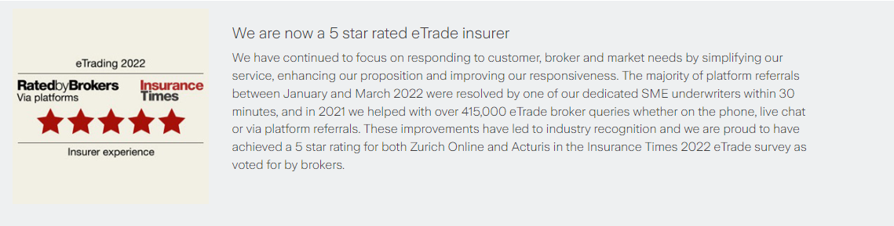
Zurich SME Insurance

Slide 5
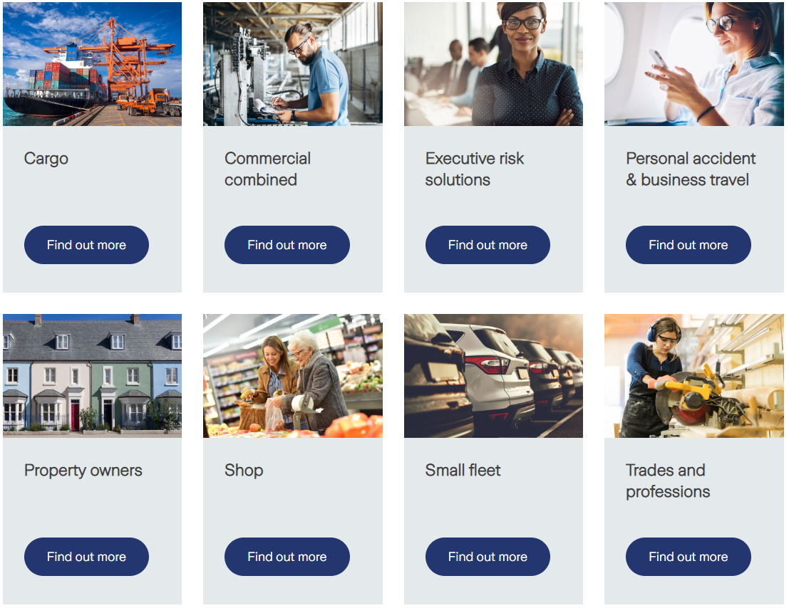
By way of products, these make up our core proposition through both Zurich Online and Acturis
We pride ourselves on our wide underwriting footprint and will look to write majority of risks presented

Slide 6
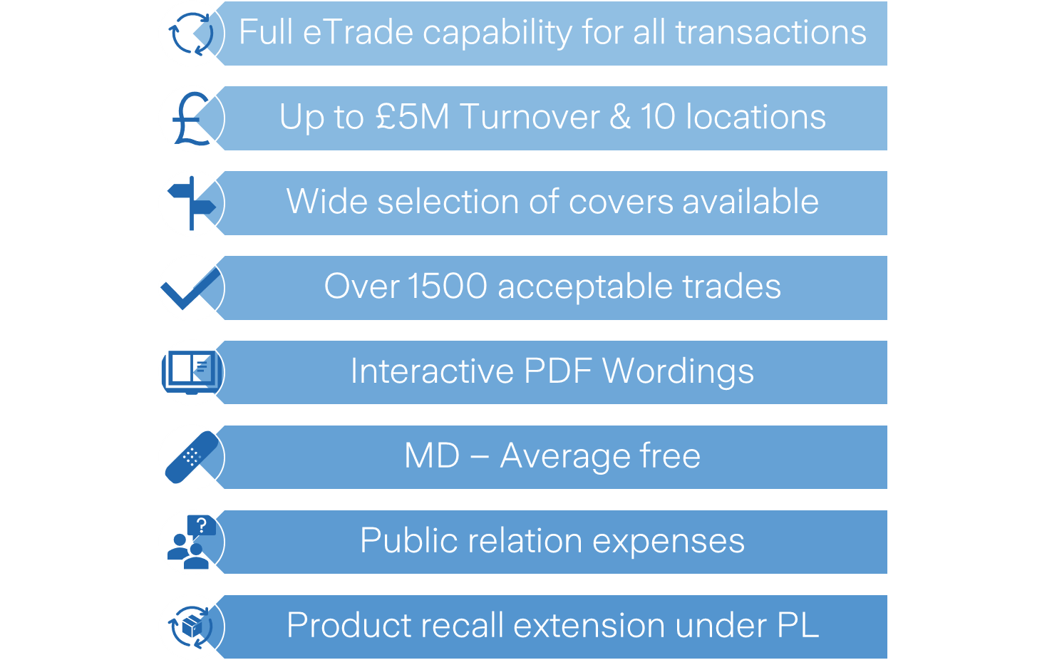







SME |Key Product Highlights
Commercial Combined
Small Fleet
Trades and Professions
Uninsured loss recovery up to £100,000
Up to 15 employees + Bona Fide Subcontractors
Up to £1.5M Turnover without referral
Include Business Contents £10,000 and Stock £15,000
Portable Tools and Equipment £10,000
Up to 15M height and 5M Depth
Up to £5M Public and Products Liability
Indemnity to Principal
Cover for Treatment risk included
Damaged caused by a commercial car or motorcycle to the property of a third party we will cover the costs up to £50m
No additional excess for young drivers.
No declarations
Electronic documentation in minutes
Legal costs & expenses indemnity £5m
Electric Vehicle Cover

Slide 7
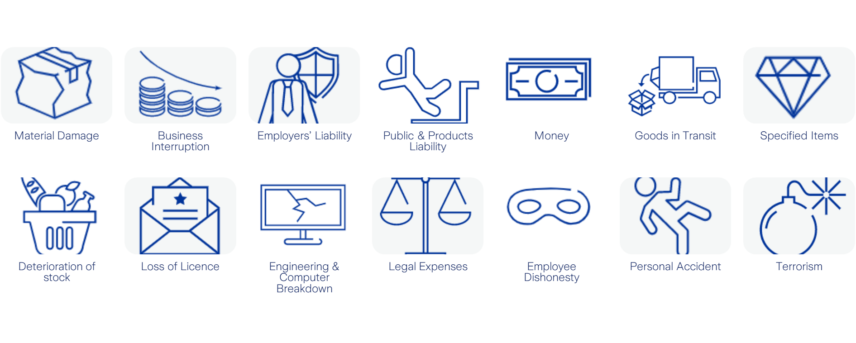

SME |Commercial Combined

Slide 8


SME |Proposition and team
At Zurich we trade SME business through both Zurich Online and through the Acturis platform. Both routes to market are serviced by our dedicated underwriting teams and provide flexibility to market.
Our dedicated underwriting teams are located between Cardiff and Leeds.
They are focused on delivering exceptional service to our brokers partners with a key focus on immediacy.
During 2021 we handled over 400,000 broker queries through phone, live chat or system referrals.
We understand the importance of speaking to and trading with underwriters. Our team is available via email, phone or live chat with a customer centric culture.
We will continue to develop and react to our broker and customer needs.

Slide 9

Zurich Mid Market

Slide 10




MM | Regional Network
Mid Market Business
Turnovers of £5M+
No. of vehicles 20+
Professional Indemnity
Engineering (Inspection & Insurance)
Marine
Local Empowered Underwriters
Our skilled regional underwriters in property, casualty, motor
and specialist lines have deep knowledge of the local area
and the specific trade sectors of Mid-Market.
Empowerment held at regional level along with our flexible approach enables our teams to adapt cover and apply additional tools to actively trade in order to deliver against your client’s expectations.
Glasgow
Leeds
Belfast
Manchester
Birmingham
East Anglia
Specialist Expertise
Dedicated Zurich International Programmes Team
For Mid-Market customers with overseas exposures our
dedicated team in Birmingham can help leverage the strength
of Zurich’s extensive global network through
our International Programmes policy.
Cardiff
London &
Croydon
Southampton

Slide 11

MM | What we cover
Our products provide extensive cover as standard. Our core sections of cover include tailored extensions, creating comprehensive protection for a variety of trades.
Our core sections of cover and examples of the standard extensions included are:
Material Damage
Stock Debris Removal
Metred Utilities
Theft Damage to Buildings
Inadvertent Omission to Insure
Trace and Access
Specified Items – All Risks
Territorial limits can be selected
Business Interruption
Professional Accountants’ Charges
Employers Liability
Indemnity to Directors and
Employees
Indemnity to Principal
Court Attendance Costs
Money
Goods in transit
Public and Products Liability
Indemnity to other parties
Consumer Protection and Food Safety Act
Legal defence costs
Pollution Clean-up-costs
Libel and Slander
We understand that not every business faces the same risks, that’s why our experienced regional underwriters will work with you to build upon the strong standard wordings with additional extensions, ensuring your customer has the protection that they need.
Our underwriters also have additional tools to actively trade with you to win and retain business, including:
Rate stability agreements
Low claims rebates
Risk Management Funds
Exclusive terms

Slide 12

MM | Our Risk Appetite
Our fully empowered, experienced underwriters deploy a very broad underwriting appetite across a range of trade industries.
First and foremost, we are customer led in our assessment of acceptance criteria, and are particularly interested in customers that:
Are well established and financially stable
Operate from purpose-built or appropriately converted premises that are well maintained
Are located in an area free from substantial flood hazards
Are appropriately protected against fire and theft
Demonstrate a proactive approach towards risk management and the reporting of risk issues
Take precautions against the hazards that arise from use of machinery, chemicals and the movement of vehicles around the premises
Have a proactive approach to business resilience and recovery with a low claim’s frequency
Have an active appreciation of the legal and regulatory environment in which they operate

Slide 13

Q&A

