Slide 1
Monthly national security summary July 2022
Summary | PIB’s View
NHS warns public of scam Covid-test text messages The NHS has warned about scam text messages that falsely tell recipients they have been in close contact with a coronavirus case and should order a test kit. It goes on to ask for bank or payment card details. | Cyber criminals are opportunistic and sadly continue to exploit concerns around the pandemic to trick people into sharing their personal or financial details. Remain vigilant to these threats, and report suspicious messages by forwarding suspect texts to ‘7726’ and emails to report@phishing.gov.uk
NCSC Powershell advice to IT and security teams The National Cyber Security Centre (NCSC) and international allies have issued a new advisory encouraging organisations to implement appropriate configuration and monitoring of PowerShell. | The new advisory is a must read by IT teams. Your Endpoint Detection & Response (EDR) tools should already be configured to monitor Powershell. Traditional antivirus is not good enough. Advisory: https://media.defense.gov/2022/Jun/22/2003021689/-1/-1/1/CSI_KEEPING_POWERSHELL_SECURITY_MEASURES_TO_USE_AND_EMBRACE_20220622.PDF
The ICO and NSCS say “No More Ransomware Payments” In a joint letter, NCSC and the ICO ask the Law Society to remind its members that they should not advise clients to pay ransomware. They understand that some firms are paying ransoms with the expectation that this is the right thing to do and they do not need to engage with the ICO as a regulator, or will gain benefit from it by way of reduced enforcement. This is incorrect. | They say: Paying ransoms to release locked data does not reduce the risk to individuals, is not an obligation under data protection law, and is not considered as a reasonable step to safeguard data. The ICO say that it will not take this into account as a mitigating factor when considering enforcement action. It will however consider early engagement and co-operation with the NCSC positively when setting its response.
Agencies in 76 countries arrested 2,000 people and recovered millions of dollars A mass operation coordinated by Interpol has seen 2,000 people arrested and $50 million seized as law enforcement agencies raided call centres around the world. | Interpol has run its 'First Light' campaign for 8 years. The aim of First Light 2022 was to crack down on social engineering & telecoms fraud, targeting the gangs behind business email compromise (BEC), telephone deception, financial & romance scams.
Promising interest in STEM subjects from young girls As we celebrate the 9th Year of International Women in Engineering Day, a survey shows an increase of over 50% among females interested in STEM subjects. | Science and maths were voted favourite subjects by girls aged 11 - 16, with 61% showing a keen interest in a STEM career. 37% say they watch YouTube videos to learn, compared to those who read books (30%) or attend after-school clubs (22%).
“We have demolished 1652 web resources” Russian hacker group Killnet says it launched a distributed denial of service (DDoS) attack on Lithuania on Monday in response to the country's decision to block the transit of goods to Russia's Kaliningrad enclave. | The tax authority in Lithuania said that it closed all systems due to the attack, although all data remained secure. Killnet seem to be taking instructions directly from the Russian state, as a Russian Security Council spokesperson threatened retaliation for the blockade and said it would have a very detrimental effect on Lithuania.
British Army's Twitter and YouTube accounts hijacked The British Army regained control of its Twitter and YouTube accounts on 3rd July after they were briefly compromised and used to promote scams. | It is likely both accounts shared the same password and were not protected by multi-factor-authentication (MFA), which is embarrassing for the MoD. If your business uses social media, ensure your accounts have MFA turned on. It is free.
Rise of the Ransomware Cartels elementus.io have produced an infographic which shows the significant dominance of Russian threat actors in the Ransomware market. | Infographic available at https://elementus.io/ransomware-cartels with a 2022 snapshot on the following slide.

Slide 2
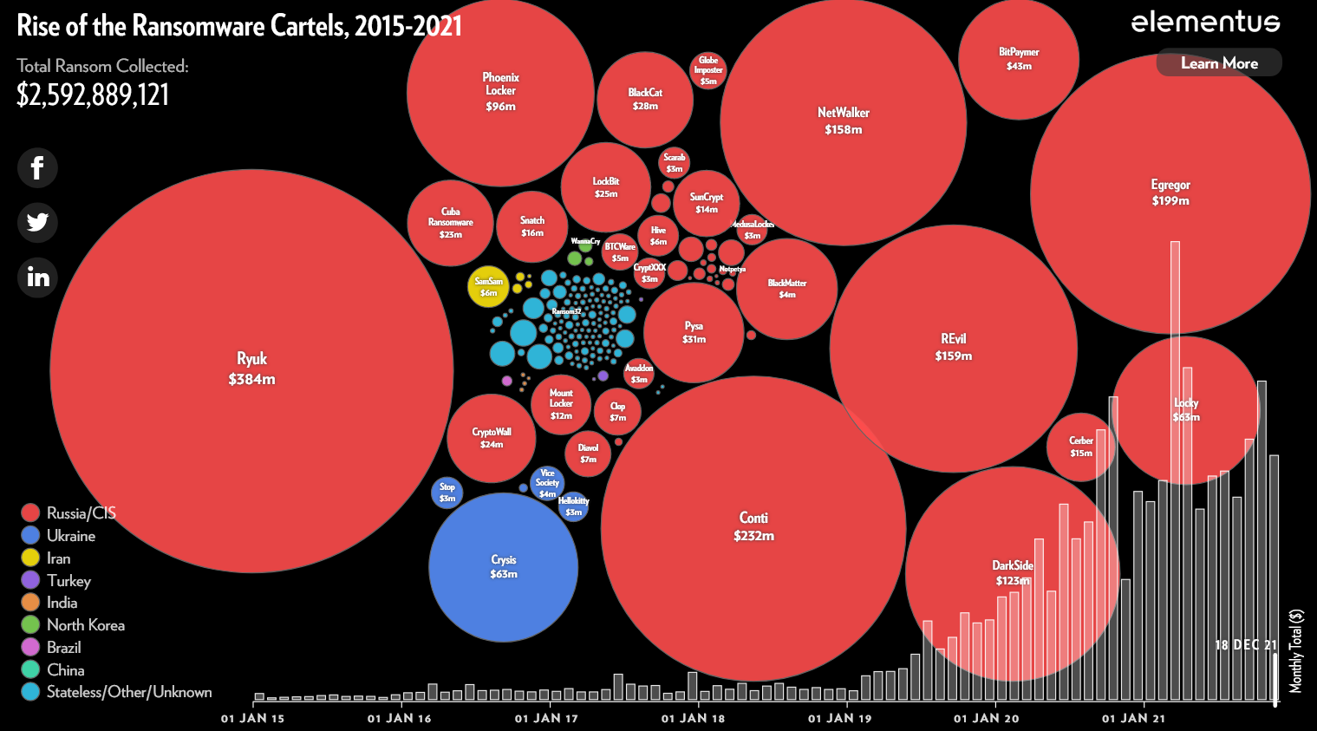
Ransomware Cartels (early 2022)
Full Infographic available at https://elementus.io/ransomware-cartels

